Slide 1

Cloud Native Application Security
Patrice Nivaggioli, pnivaggi@cisco.com
Cisco Emerging Technologies and Incubation
April 2023

Slide 2








Application Development is Fundamentally Changing
Saas
Saas
SECURITY
COLOCATION
Saas
Saas
CAMPUS
BRANCH
DATA CENTER
EDGE

Slide 3
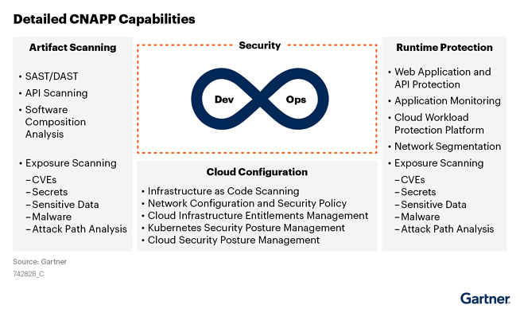
Cloud Native Application Platform

Slide 4

Application Connectivity with Service Mesh
Application Example:
Contactless cash withdrawal at local ATM
Customer Journey
Customer locates and drives to ATM
Authenticates on phone enters amount
Picks up cash
without touching ATM
Picks up cash
without touching ATM
Digital Journey
SaaS
Mobile App
front-end
Application backend via Cloud (one, many)
Customer data via SaaS
Account consistency via on-prem transaction systems
Branch edge footprint
for cash
Update cloud back-end and mobile front-end
Service Mesh
1. Scale/Hybrid 2. Secure Connectivity (mTLS) 3. Traffic Management
4. Observability 5. Service Level Objectives 6. Synchronous/Async Apps
7. Operator Managed

Slide 5
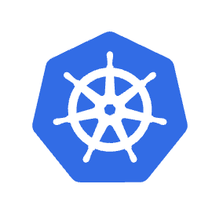
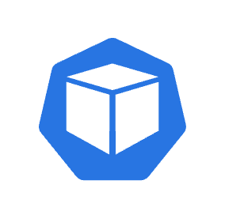



Istio Service Mesh and API Security
Kubernetes Control Plane
Istio Control Plane
webhooks
admin controller
App PODs
App PODs
api security
traces
3rd Party API
vault
Gway

Slide 6
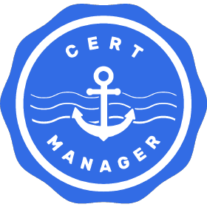








To go further with Opensource projects
Identity
Management
Service
Mesh
Cloud Native Application Secure Connectivity
CNI
SPIRE
Istio
Envoy
WebAssembly
Calico

Slide 7

Cloud Workload Protection
Application Overview:
Contactless cash withdrawal at local ATM
Customer Journey
Customer locates and drives to ATM
Authenticates on phone enters amount
Picks up cash
without touching ATM
Picks up cash
without touching ATM
Digital Journey
SaaS
Mobile App
front-end
Application backend via Cloud (one, many)
Customer data via SaaS
Account consistency via on-prem transaction systems
Branch edge footprint
for cash
Update cloud back-end and mobile front-end
Cloud Workload Protection
1. SBOMs 2. Workloads Vulnerabilities Mgmt 3. Admission Policies
4. APIs Security 5. Serverless Integrity

Slide 8
Kubernetes Admission Controller Architecture
Image and Runtime Security Example
Kubernetes Control Plane
webhook
admin controller
App PODs
App PODs
CVEs DB
scanner
sbom
Registry
ephemeral
scanner POD

Slide 9







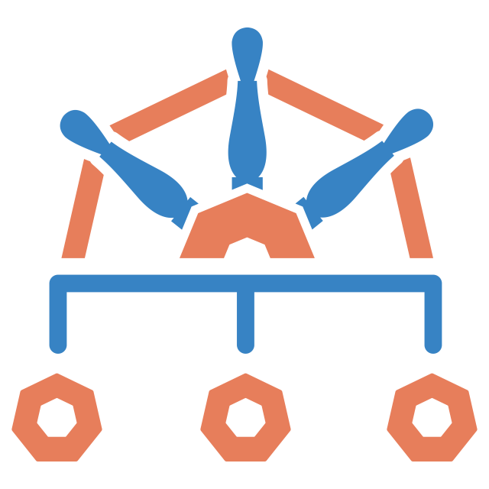


To go further with Opensource projects
Cloud Native Application Security
SBOM
Scanner
Artefacts
Integrity
Policy
Engine
API Securirty
Serverless Securirty
KubeClarity
OPA
Sigstore
CycloneDX
APIClarity
FunctionClarity
SLSA
Kyverno

Slide 10
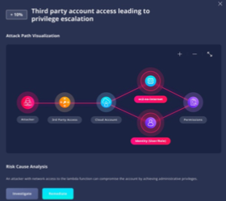
Cloud Security Posture Management
Attack Path vs Attack Vector

Slide 11

Conclusions
Software has eaten the word…
and Opensource is eating Software
You can’t protect what you can’t see
You can’t protect what you don’t understand
Next > https://openssf.org/

Slide 12
Thank You !

